Slide 1



Movie
Analysis
project

Slide 2
Analysis Process
1. Data Collection
2. Data Cleaning & Preparation ‘Using Python’
3. Exploratory Data Analysis (EDA) ‘Using Python’
4. Data Analysis & Modeling ‘ Using Power BI’
5. Data Visualization ‘ Using Power BI’
6. Insights & Recommendations ‘ Using PowerPoint’

Slide 3
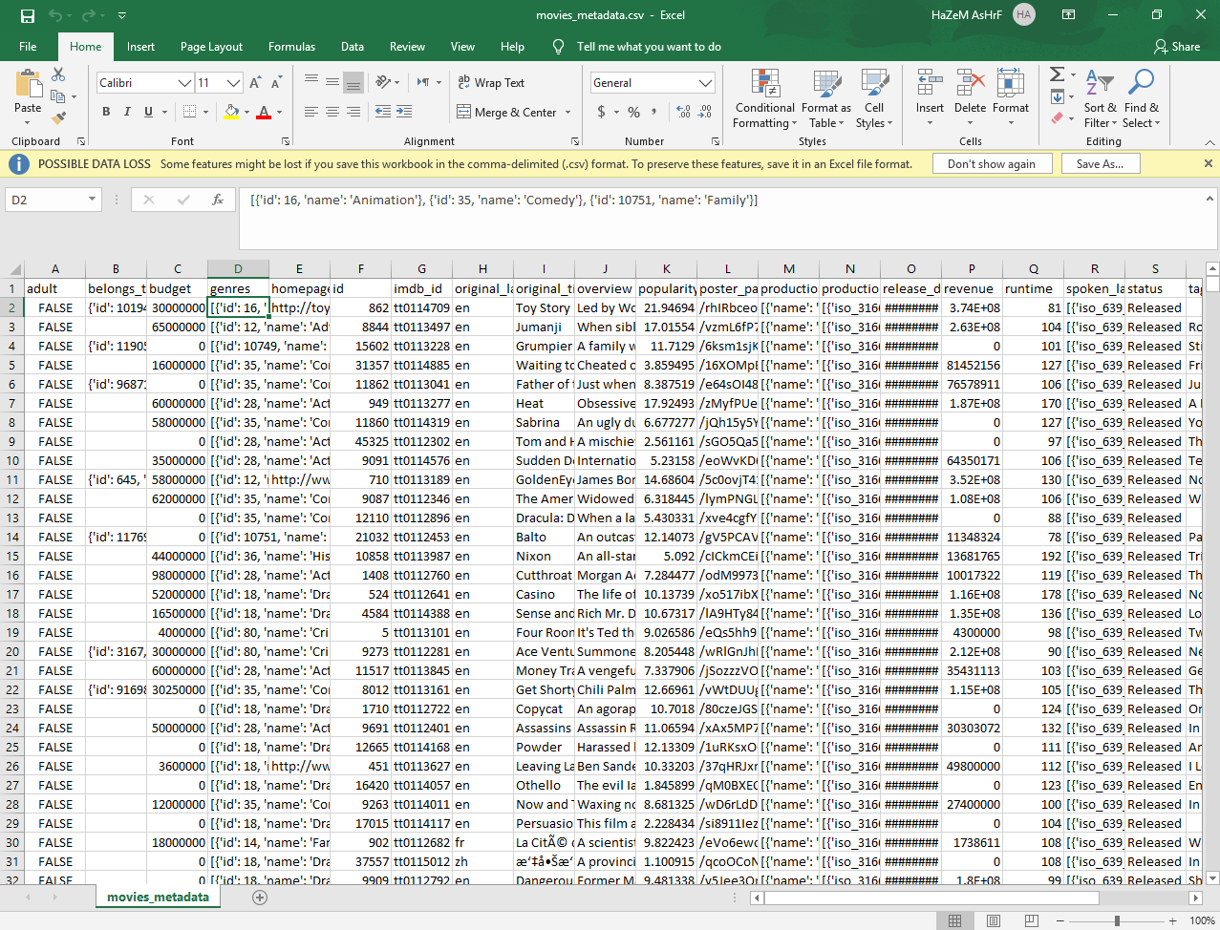
1. Data Collection
The data was provided by the instructor in the form of raw files containing the information required for the analysis.

Slide 4

Data Transformation
The original data was provided in JSON format. It was transformed into a structured table format by extracting lists and creating separate columns to make the data suitable for analysis.
Data Cleaning & Preparation ‘Using Python’

Slide 5
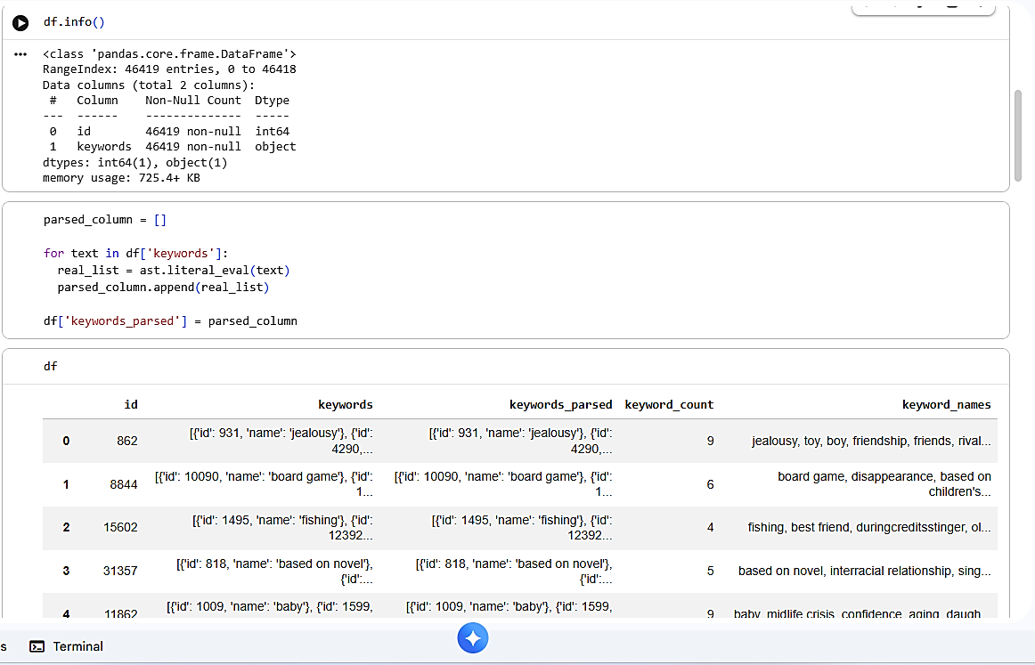
Exploratory Data Analysis (EDA) ‘Using Python’
Python was used to explore the dataset, identify patterns, analyze data distribution, and check for relationships between variables.
Power BI was used to create interactive visualizations and dashboards to represent the analyzed data and highlight important trends.

Slide 6

Data Modeling
The cleaned dataset was imported into Power BI, where relationships between tables were created and the data model was prepared for analysis.
Analysis Process
Power BI was used to create calculated measures, analyze key metrics, and identify patterns and trends within the dataset.
Data Analysis & Modeling ‘ Using Power BI’

Slide 7
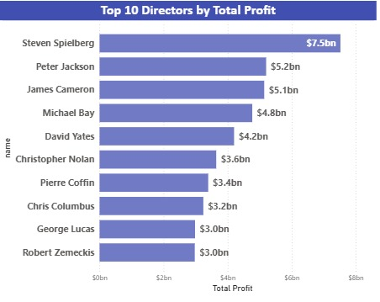
Data Visualization ‘ Using Power BI’
Interactive Dashboard
An interactive Power BI dashboard was developed to present the analysis results in a clear and user-friendly way.
Dashboard Features
Interactive filters and slicers.
Dynamic charts and KPIs.Revenue, Budget, and ROI analysis.
Performance comparison by Genre, and Company
Objective
Transforming complex data into clear visual insights that support faster and better decision-making.

Slide 8
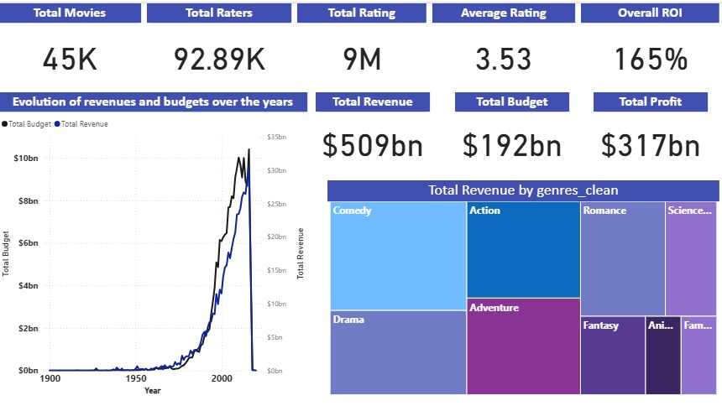
What the data shows
Both movie budgets and revenues have grown significantly over the years. However, revenue has increased at a faster rate, resulting in a total profit of approximately $317 billion.
Why it matters
This indicates that the movie industry has become increasingly profitable over time, despite the continuous rise in production costs.
Recommendation
Continue investing in high-performing movie categories while carefully managing production budgets to maximize profitability.
Insights & Recommendations

Slide 9
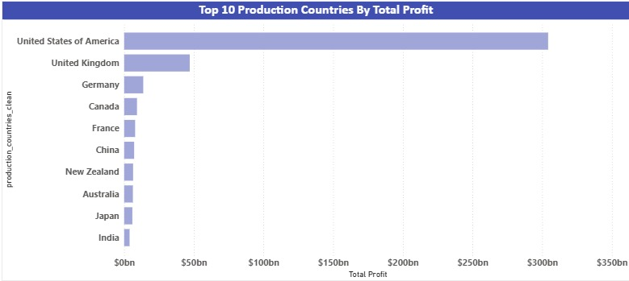
What the data shows
​It displays the massive gap in total profit per country, dominated by the United States (over $300bn), followed by the United Kingdom (~$50bn), Germany, Canada, France, China, New Zealand, Australia, Japan, and India.
Why it matters
​It underlines the overwhelming financial dominance of the US film market in total global box-office profits.
Recommendation
​Market Entry: Prioritize distribution and marketing in the US market to tap into the largest pool of cinematic profits globally
Insights & Recommendations

Slide 10
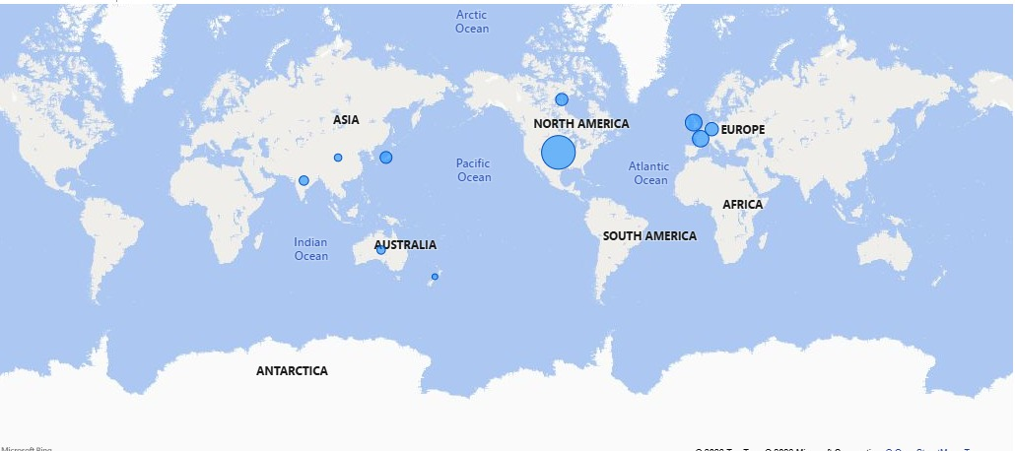
A Map for the previous chart

Slide 11
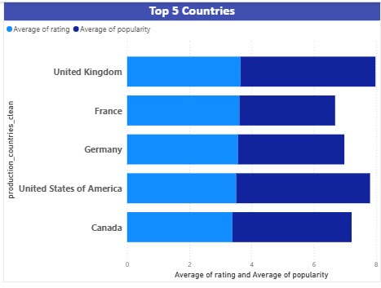
What the data shows
The best 5 overall countries by profit , rating , and popularity​It shows an identical Average Rating (~3.5) across the top 5 countries, with the USA and UK leading in overall Average Popularity over France, Germany, and Canada.
Why it matters
​It indicates that English-speaking productions hold a global distribution advantage and higher audience reach despite similar film quality ratings across nations.
Recommendation
Prioritize co-productions with US and UK studios to maximize global audience reach and popularity metrics.
Insights & Recommendations

Slide 12
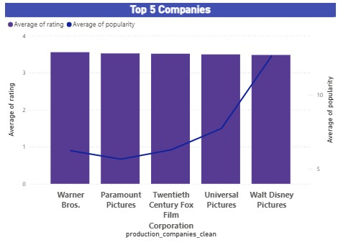
What the data shows
​It shows that while all top 5 production companies maintain an identical Average Rating of around 3.5/5, Walt Disney Pictures drastically outperforms competitors in Average rating
Why it matters
​It illustrates that high audience satisfaction is consistent across major studios, but Disney possesses superior marketing and audience engagement capabilities.
Recommendation
​Marketing Strategy: Analyze Disney's distribution and branding models to learn how to convert critically stable films into massive cultural and popularity trends.
Insights & Recommendations

Slide 13
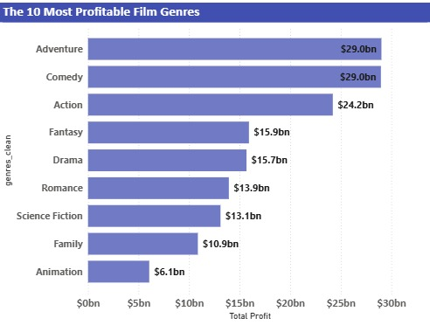
What the data shows
​It ranks the top profitable genres, led by Adventure and Comedy at $29.0bn each, followed by Action ($24.2bn), Fantasy ($15.9bn), and Drama ($15.7bn).
Why it matters
Audience demand is not equally distributed across genres. Some genres consistently achieve stronger financial performance.
Recommendation
Prioritize investments in high-revenue genres while exploring opportunities to improve the performance of lower-performing genres.
Insights & Recommendations

Slide 14
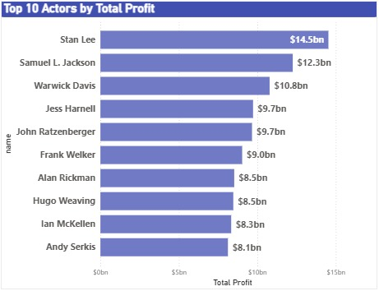
The top 10 actors generated the highest total profit. However, the most profitable actors are not always the ones with the highest ratings or popularity.
What the data shows
The top 10 actors generated the highest total profit. However, the most profitable actors are not always the ones with the highest ratings or popularity.
Why it matters
Commercial success depends on multiple factors, including movie selection, genre, and audience demand, not just an actor's popularity.
Recommendation
Evaluate actors using both financial performance (Profit/ROI) and audience metrics (Rating and Popularity) before making casting decisions.
Insights & Recommendations

Slide 15
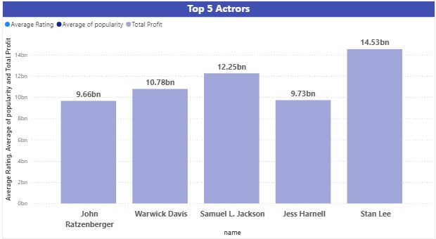
What the data shows
​It displays the top 5 actors by Total Profit, led by Stan Lee ($14.53bn), Samuel L. Jackson ($12.25bn), Warwick Davis ($10.78bn), Jess Harnell ($9.73bn), and John Ratzenberger ($9.66bn).
. Why it matters
It demonstrates the massive commercial footprint of stars tied to blockbuster franchises (Marvel, Harry Potter, Star Wars, Pixar), driving the highest box-office returns ; and represent the Commercial success depends on multiple factors, including movie selection, genre, and audience demand, not just an actor's popularity​ .
Recommendation
Leveraging these key actors or franchise icons in film projects serves as a strong catalyst for driving audience engagement and maximizing theatrical profitability
Insights & Recommendations

Slide 16
What the data shows
Both movie budgets and revenues have grown significantly over the years. However, revenue has increased at a faster rate, resulting in a total profit of approximately $317 billion.
Why it matters
This indicates that the movie industry has become increasingly profitable over time, despite the continuous rise in production costs.
Recommendation
Continue investing in high-performing movie categories while carefully managing production budgets to maximize profitability.
Insights & Recommendations

Slide 17
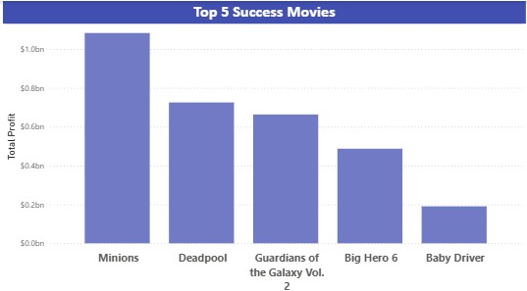
What the data shows
​It ranks the top 5 most profitable movies, led by Minions (over $1.0bn profit), followed by Deadpool, Guardians of the Galaxy Vol. 2, Big Hero 6, and Baby Driver.
Why it matters
​It highlights that animated family films and comic book adaptations deliver the highest absolute net profit margins.
Recommendation
Focus investment on animated family features and superhero/action genres to maximize absolute profit generation.
Insights & Recommendations

Slide 18
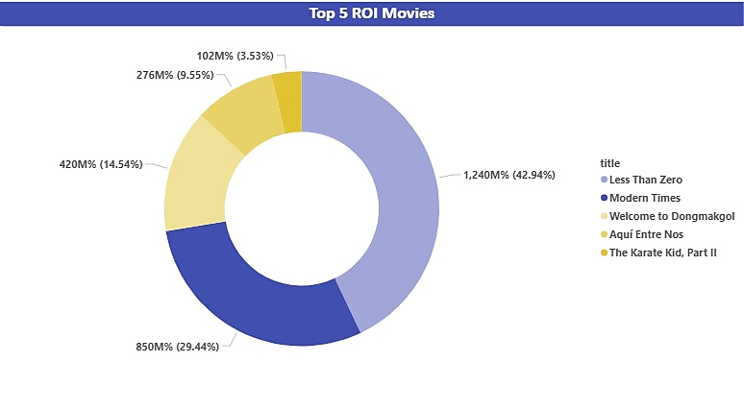
What the data shows
Surprisingly, several lesser-known movies achieved the highest ROI, outperforming many blockbuster productions.
Why it matters
High profitability does not always require a large budget or widespread popularity. Smaller productions can deliver exceptional returns on investment.
Recommendation
Increase investment in promising low- and medium-budget projects with strong ROI potential instead of focusing exclusively on blockbuster films.
Insights & Recommendations

Slide 19

Thank You!

